Slide 1
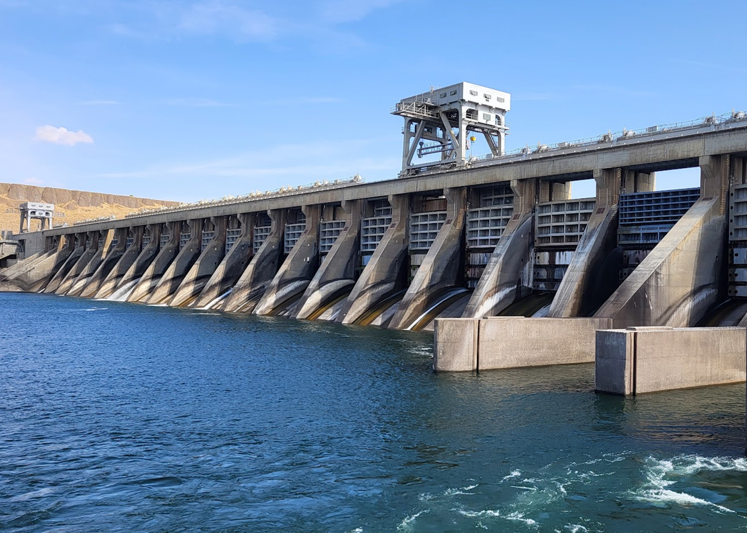
Mcnary spillway status
FPOM
11 June 2024

Slide 2
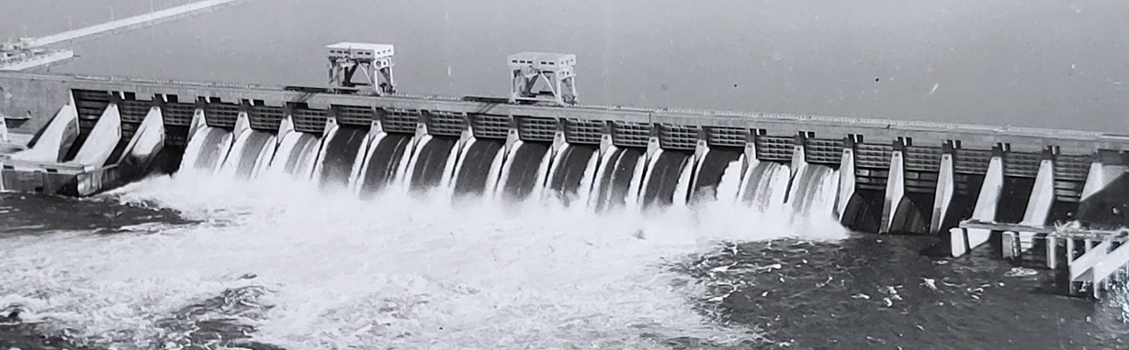
McnARY SPILLWAY
Operational in 1954
22 Spillbays with double leaf vertical lift gates
2 Cranes (#6, #7) only initially,
200 ton (400,000 lbs) capacity.
Routinely operated gates in split leaf

Slide 3
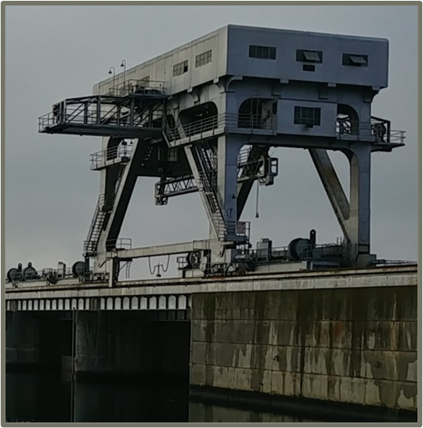
McnARY cranes 6 & 7
Overloaded by estimated 20% according to BDI tests in 2003/05- not counting for lifting beam or frictional losses. – Violation of American Society of Mechanical Engineers (ASME) and Engineer Manual (EM) 385.
Gantry crane frames do not comply with current American Institute of Steel Construction (AISC) codes - Under breakdown torque simulations, the downstream legs fail.
The electrical system is outdated. Asbestos. DC hoist controls at risk of failure. Obsolete component replacement is becoming more challenging.
Frequently down for weeks or months at a time – most recently a gantry drive gearbox failure required bearings that are no longer readily available.
Recently had a main hoist gearbox replacement to address severe vibration issues, with mixed results.
January 2023, Cranes 6 & 7 were limited to two engineered lifts (250 tons) per year.
Lifts that do not overload crane capacity are not limited

Slide 4
McnARY hoists
1976, 16 Ederer hoists added, 175 tons (350,000 lbs) capacity
Flow deflectors added
Spillway predominately operated as full gates
2002/2003, Four Transco hoists added.
350,000 lbs capacity
2002, Failure of hoist gearbox coupler
2003-2005, Testing indicated all hoists were overloaded, 13 were > 125% overloaded
Up to 480,000 lbs of load. Did not include sheave friction.
2004-2009, Rehab of some gates wheel bearings, guide slots, guide shoes, replaced seals
Minor improvement only
2007, Hoist replacement project initiated
2020, Work restriction while hoists were under load implemented to reduce risk to health and human safety
2021, Load cell data collected on four hoists for prototype hoist project showed overload condition
2022, Hoist #6 failed, gears showed severe pitting due to material fatigue from high contact stresses,
replaced with hoist from bay #16. Bay #16 RTS after about three month outage.
Hoist #15 OOS for one week for repairs
Hoist #20 taken OOS for repairs
Hoist #21 gearbox coupler failed and brakes failed during closure causing gate to fall on sill
October 2023, Hoist operations were limited to either no (13) or two (7) overload lifts per year

Slide 5
McnARY hoists
Pitted north drum gear
Unworn gear
Notes:
Wear is sign of metal fatigue and causes increased frictional loading that in turn increases further wear.

Slide 6
McnARY hoists
Pitting on south pinion gear
Unworn pinion gear

Slide 7
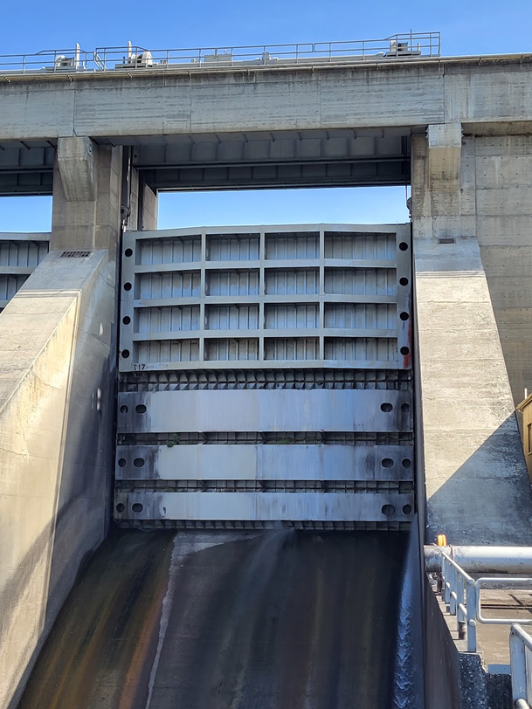
McnARY spill gates
2022, Testing of lifting eyes showed deterioration and overload of design capacity
Gate girders; several were close to failure for normal operations, and many did not
meet criteria for emergency operation
2023, Spillbay #16 closed to repair cracks in dogs and dog mounting points
Bays #1, #3, #21 taken OOS to repairs dogs. Other bays to follow over the next year
Result of structural analysis is that all 22 (+2 spares) spill gates should be replaced

Slide 8
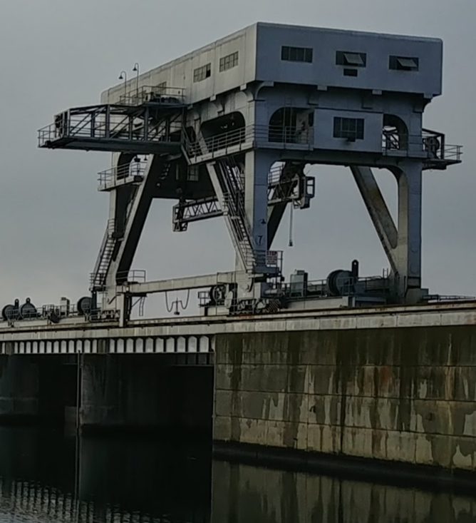
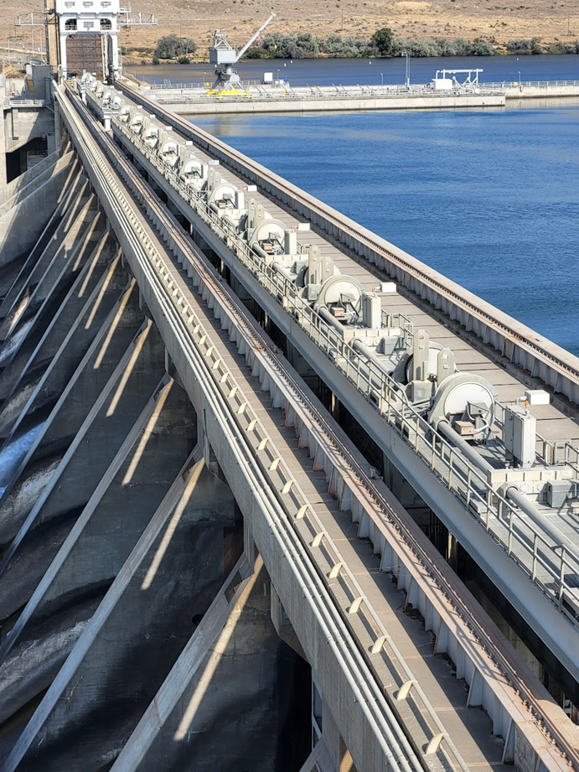
mCnary spillway upgrade status scope of spillway upgrades
Spillway Gate Dogging Mechanism Repairs (NREX):
Repair and restore dogging mechanisms to allow safe dogging of gates.
Replace Spillway Cranes 6 & 7 (BPA Joint Capital):
Replace spillway gantry cranes with uprated (350 ton) cranes (PRIORITY)
Replace spillway gate lifting beams with uprated lifting beams
Gate Hoist Replacements (BPA Joint Capital):
Replace all 20 gate hoists (PRIORITY). Add 2 new gate hoists so each spill bay has a hoist. 350 ton capacity
Spillway Gate Replacement (BPA Joint Capital):
Based on 2023 structural analysis, we must replace all spillway gates with uprated capacity for sheave friction and hydraulic down-pull forces.
Spillway Gate Repair Pit Upgrade (BPA Joint Capital):
Remove lead and asbestos.
Add explosion-proof lighting, ventilation, doorways, electrical, pedestal upgrades, deck slab repairs and handrail upgrades, and fire protection.
Notes:
- Spillway Gate Repair Pit Upgrade is not a priority considering we are not pursuing gate rehab. We will need a functioning/upgraded gate repair pit for routine O&M in the future, so it is still a need.

Slide 9
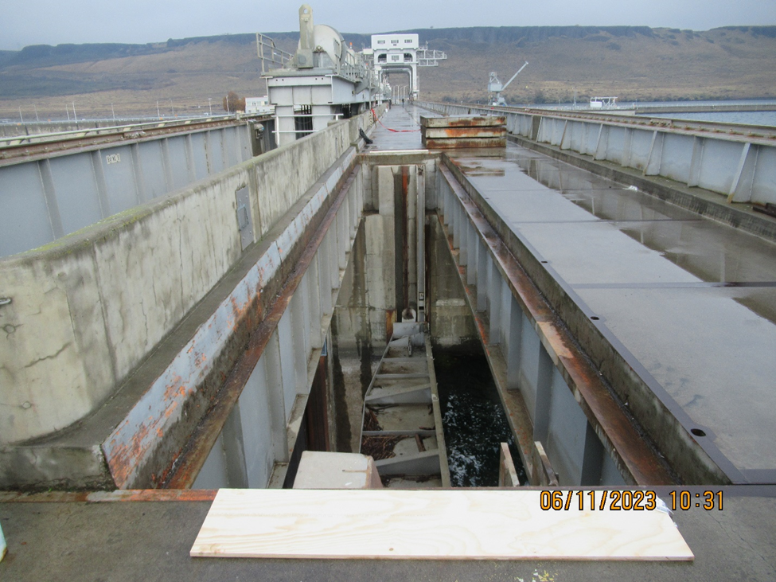
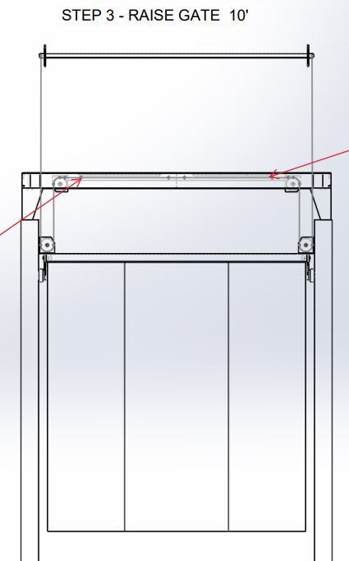
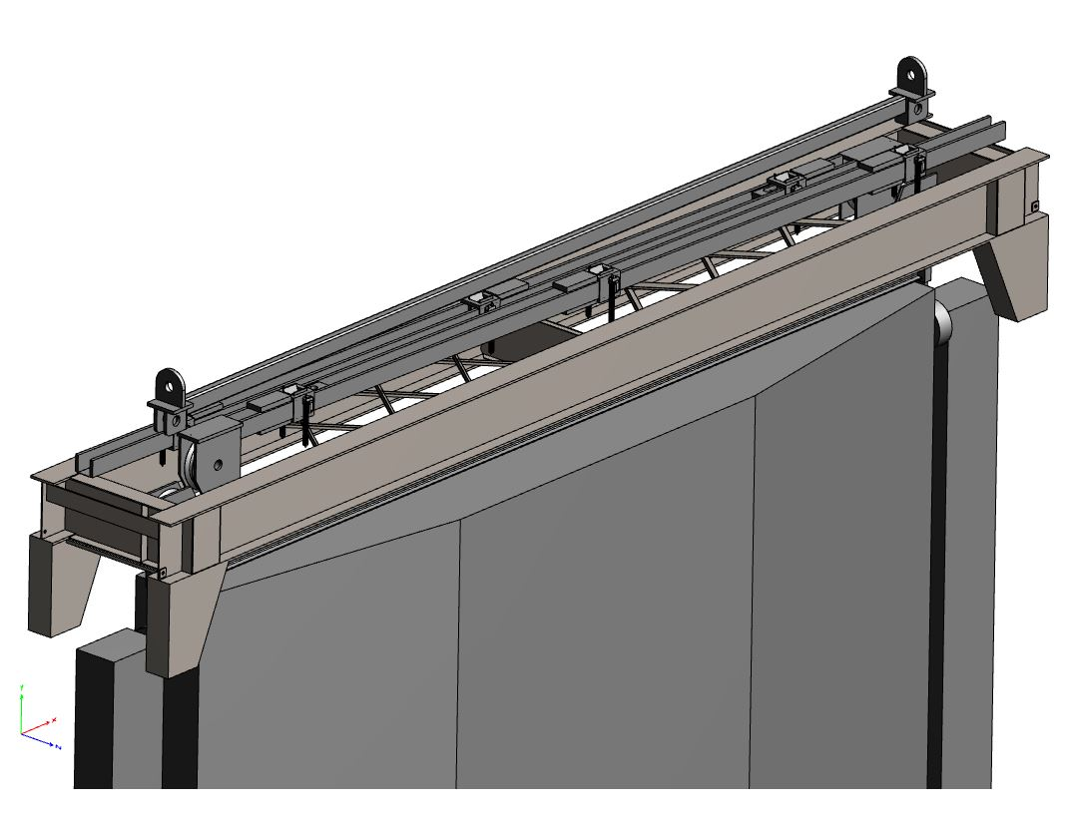
mCnary spillway upgrade status scope of spillway upgrades
Spillway Deck Safety Handrail (NREX):
Procure 22 new sets of handrail for the upstream spillway gate slots
Move 13 spillway gates and spillway gate hoists to upstream slots
Operate spillway in upstream, split-leaf configuration for spill and fish passage requirements (PRIORITY)
Spillway Lifting Auxiliary Beams (SLABs) (BPA Joint Capital):
Purchase new SLABs to allow use of spillway cranes without overloading (PRIORITY)
Reduces spillway gate load from the spillway cranes and allows spillway crane operation within acceptable load limits
Notes:
Spillway Deck Safety Handrail is needed to be able to use the upstream slots. There is only one set of handrail for maintenance, so we need to purchase another 21 sets so that each bay is protected during upstream spill operations. This project includes labor for O&M staff to move all of the gates, split the gate leafs to upper and lower sections, and set up all of the spillway gate hoists on the upstream slots.
SLABs take half of the spillway gate load off the spillway cranes, which means we can use the spillway cranes without overloading

Slide 10
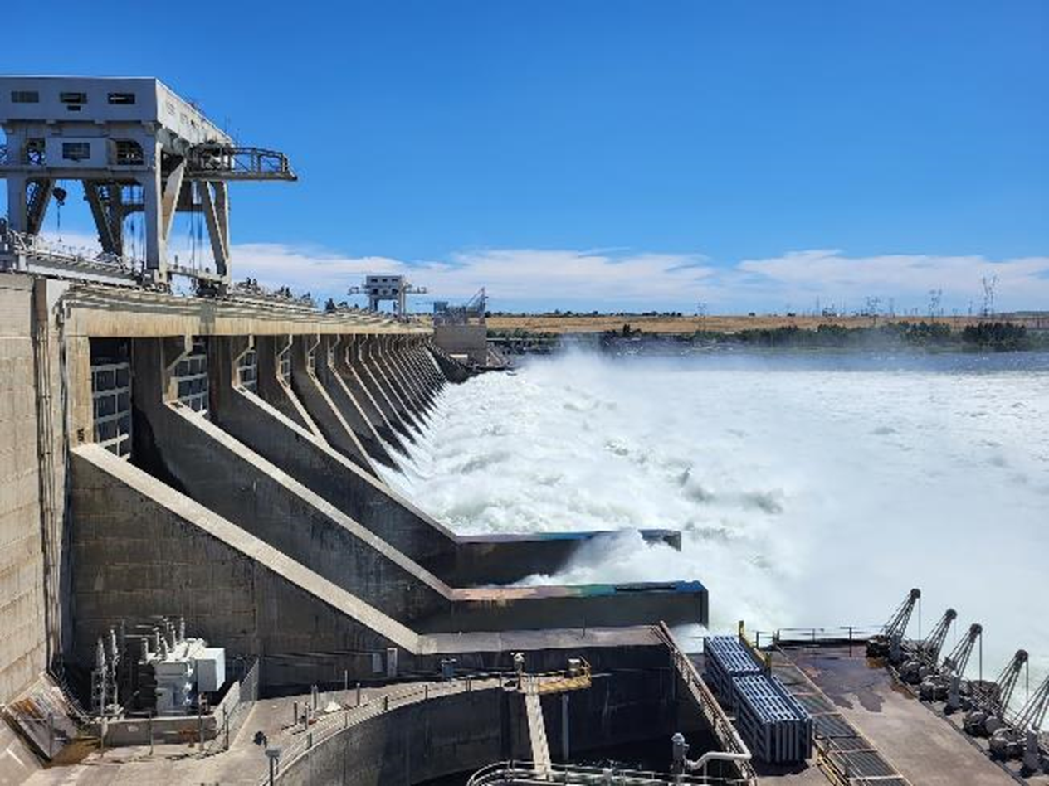
McNary spillway crane milestones
Kick off August 2023
Phase 1 Approval April 2024
Ready to Advertise September 2024
Award March 2025
Onsite Construction Summer 2027

Slide 11
Spillway gate hoist replacements milestones
Kick off Dec 2014
Phase 1 Approval Nov 2019
Phase 2a Approval Jul 2022
Contract Award Apr 2024
Onsite Construction Apr 2025
Phase 2b Approval Jun 2024
Contract Award Nov 2024
Onsite Construction Sep 2025 – 2032 (~Three per year)
Phase 2a = Prototype Spillway Gate Hoist (1 hoist)
Phase 2b = Remaining Spillway Gate Hoists (21 hoists)

Slide 12
Spillway gate hoist replacements
McNary Spillway Hoist Phase 1:
- prepare plans and specifications based on recommended alternatives, including a “prototype”
rehabilitation of one gate and uprate of one hoist
- prepare contract documents to BCOES level
- prepare total project cost estimate
- advertise contract and pre-award acquisition actions
Operational requirements for the new spillway gate hoist:
Hoist Designation Gate hoist
Rated Capacity 400 tons (800,000 lbs)
Lift Speed 1 ft/min
Motor Power 40 HP max
Picking Distance 20 ft(Gate Opening)
Over Travel 1 ft
Rated Voltage 480 V
New hoist motor capable of 200 percent overload torque for one minute from zero speed to base speed.
Include a new gate lifting beam rated to match 400 ton capacity.
Use commercially available off-the-shelf components as much as is feasible

Slide 13
Spillway gate hoist replacements
McNary Spillway Hoist Phase 1 (continued):
Equipment such as motors, reducers, gearboxes, etc. shall allow for easy extraction and installation.
Use Environmentally Acceptable Lubricant (EAL) for components not permanently sealed.
Include a load-limit visual/audible system for when the load-limit has been exceeded. The load-limit system shall include load-sensing electronics and an alarm light. The alarm setpoint shall be adjustable.
Include load cells to provide continual load measurement signals with an emergency stop pushbutton.
One of each item, rating and type of equipment furnished as selected by the Contracting Officer, shall be given a complete test witnessed by the Contracting Officer. No equipment shall be shipped until it has been approved for shipment by the Contracting Officer.
Each hoist shall be given a complete functional test after installation with the gate attached.

Slide 14
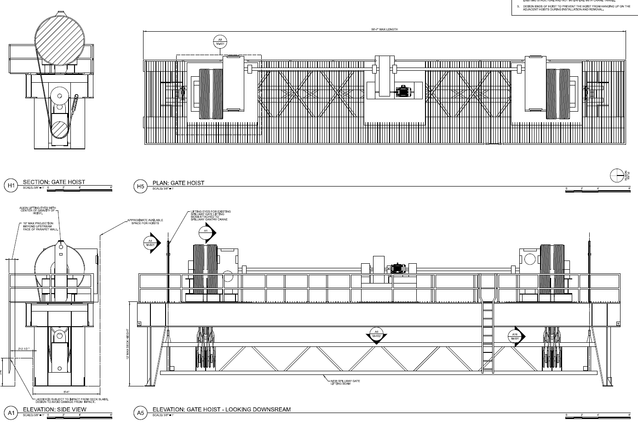
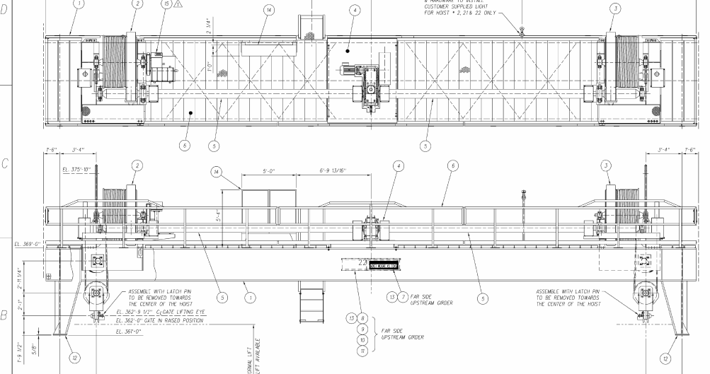
Spillway gate hoist replacements
Old Hoist Design
New Hoist Design

Slide 15
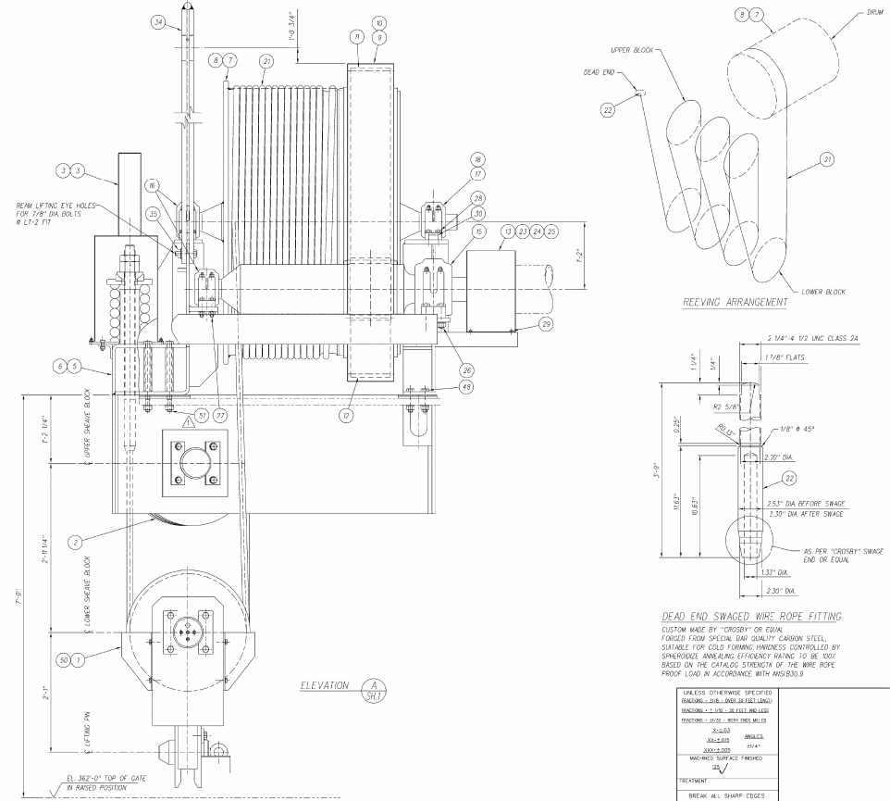
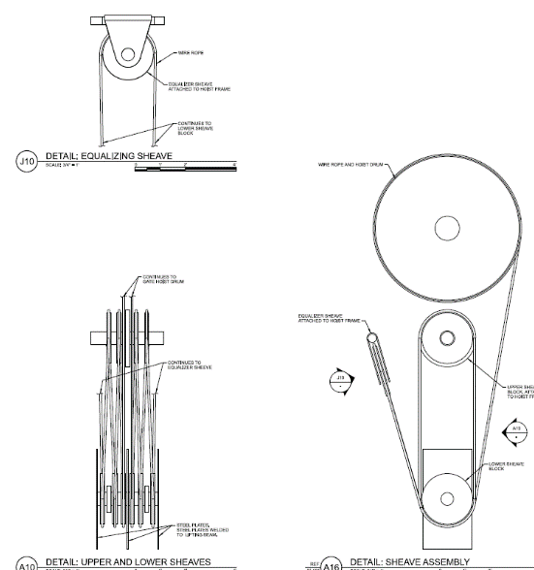
Spillway gate hoist replacements
Old Hoist Design
New Hoist Design

Slide 16
11 June 2024
McNary Spillway Working Schedule
MCN Replace Spillway Cranes 6 & 7
Phase 1a under way. Presented to CWG, Few points to address for Phase 1 Design.
Phase 1 Design FY24-25? (pending appropriated $$s)
Award 1 crane (pending appropriated $$s):
Start fabrication crane 1 in FY26
Award 2nd crane (pending appropriated $$s):
MCN Spillway Major Rehab Evaluation Report (MRER)
Creating new project for FY24-25 budget request
MCN Spillway Hoist Replacements
First hoist in final design Contracted awarded.
Award prototype early FY24. Install FY26-Early FY27
Award follow-on contract for remaining hoists FY26: three per year?
Safety handrails – Contracted awarded. Construction FY24 ~ July or August
SLABS – Phase 2 Approved. Fully Funded. Close to solicitation. In design. Award Contract July ‘24. Construction FY24-FY25
MCN Spillway Gate Replacements
Phase 1a approval pending 2024 Capital Work Group Meeting
Phase 1 design in FY24-25
Award:
New spillway gates delivered FY26?: Three per year?
MCN Spillway Gate Dogging Mechanism Repair underway with FY23 NREX funds.
Funded. Repairs to occur in FY25 and complete in FY26
MCN Spillway Gate Repair PIT Upgrade
Phase 1a has been approved, but no appropriated match
Lower priority since gates are to be replaced
Repair pit will likely be used for storage when new spillway gates start to be delivered.
Modeling – Latest estimate, $2.3 M to create new model
Under construction.
Estimated November 2024 for model completion.
December Model Calibration. January modelling trials.

Slide 17
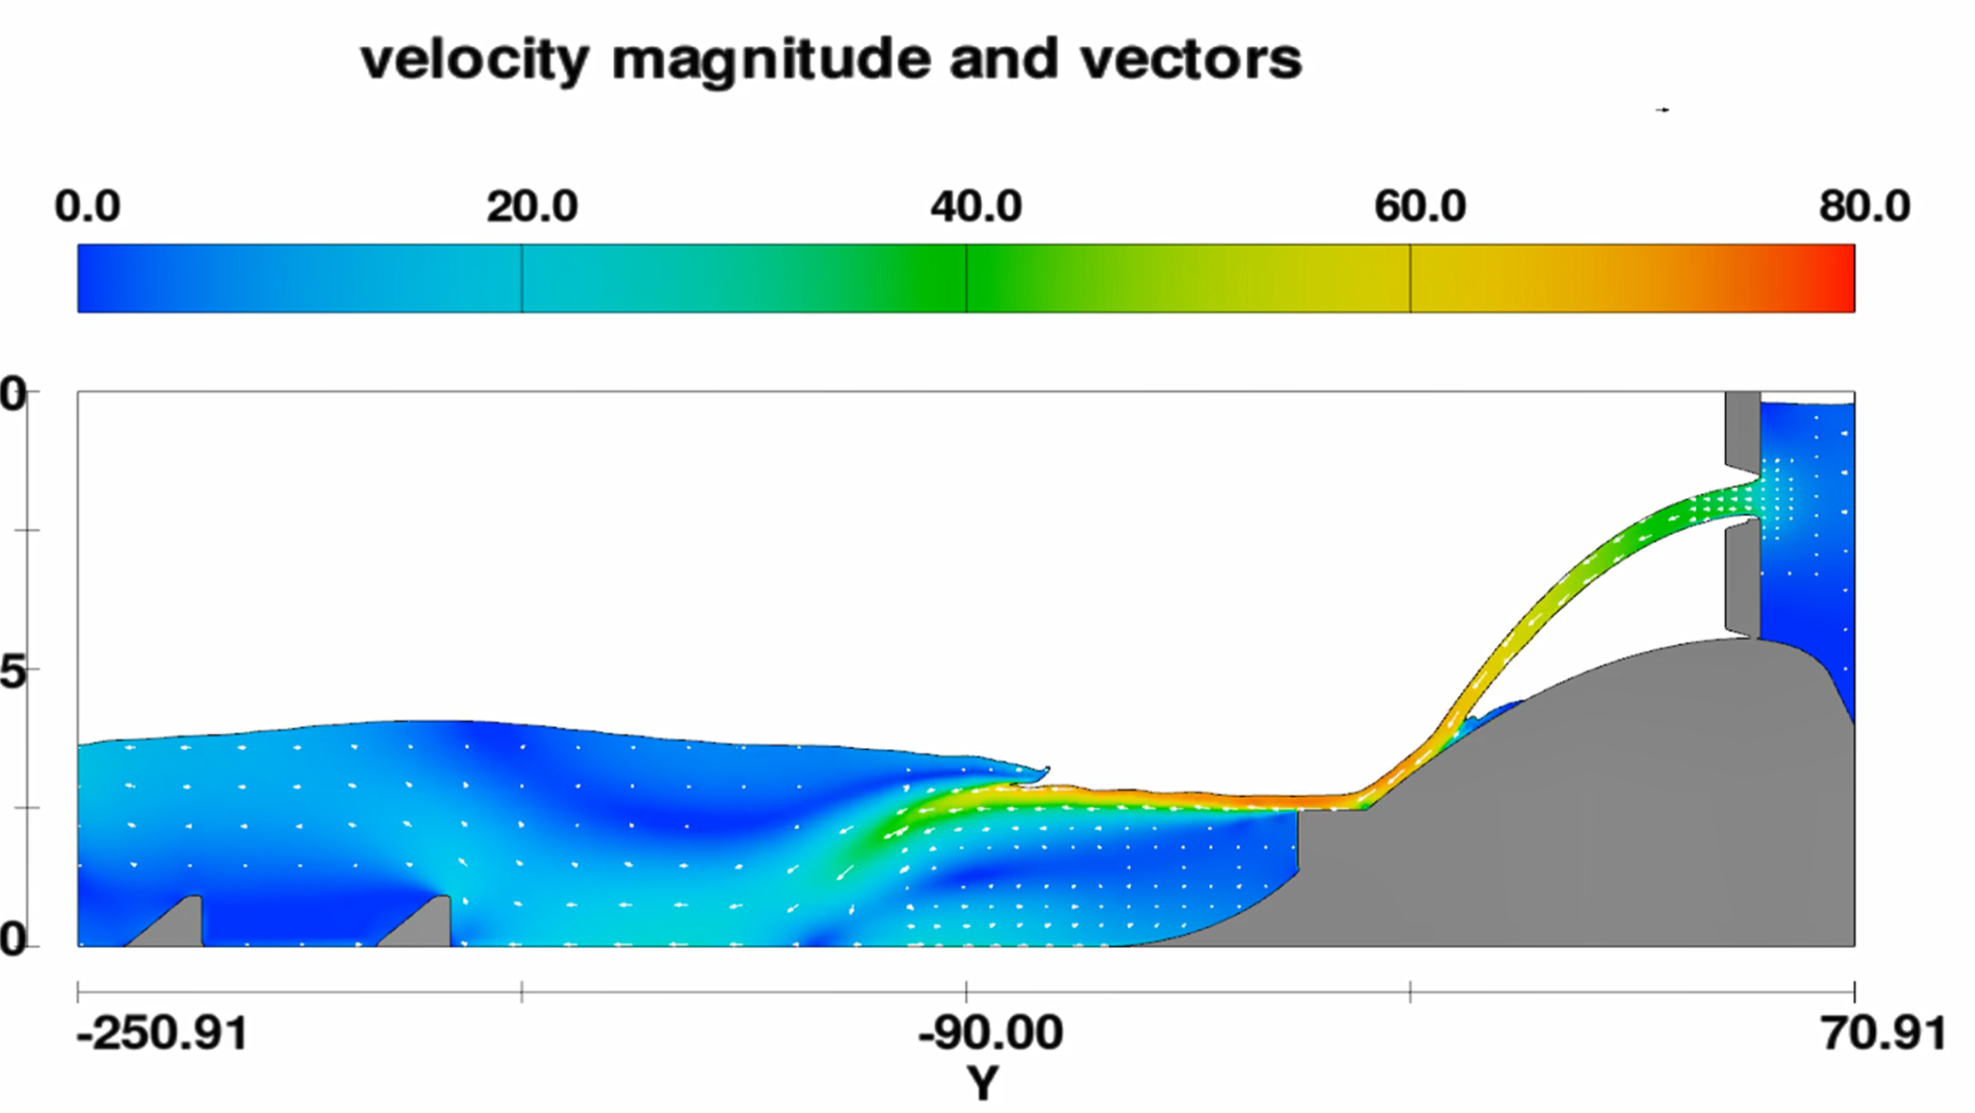
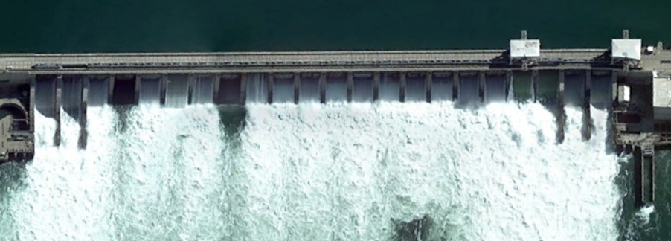
11 June 2024
modified spill operations
Retain two TSW’s in normal location
Move 13 gates and hoists to upstream slot and use in split leaf configuration
Construct new control cables
Procure materials for handrails with Small Cap – Contract awarded.
Assemble handrails in-house
13 gates are in upstream slots
11 hoists moved to upstream slots. Cranes to be used for two gates
Retain 7 gates in downstream slot closed in full gate configuration
Needed to maintain Standard Project Flood (SPF) capacity
Incorporate use of SLAB’s when available
Modeling estimate 125% TDG spill level with
split-leaf spill, ~220 kcfs (vs. 260-270 in 2023)
No change to spill operations at other projects
24MCN02 MFR
Gates 1 & 2 are in use
Spill Tables and FPP change form developed.
Cranes operating gates 6 & 9 cannot be adjusted hourly.
Split-leaf upstream slot
TSW
Full gate downstream slot

Slide 18
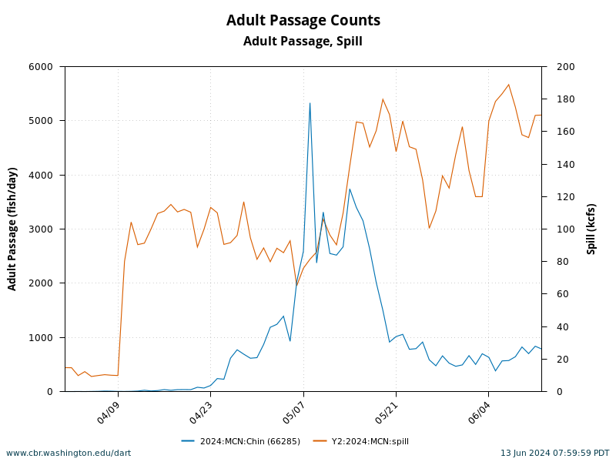
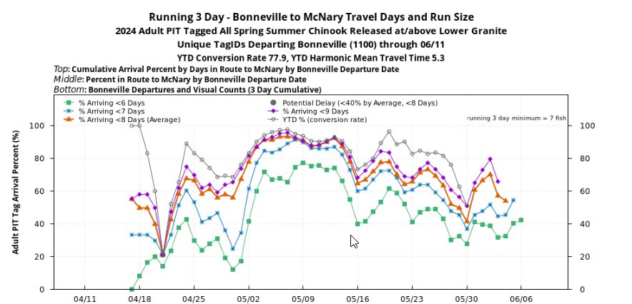
McNary Chinook Salmon To Date

Slide 19
Modified Spillway Operation evaluations
SRWG has meet several times to discuss evaluation plans
Research Summary
FY24 DIRECT INJURY STUDY OBJECTIVES:
Estimate direct injury and survival of yearling Chinook salmon passing through a McNary Spillbay after being set in the upstream slot in split-leaf operation by direct releases of fish equipped with balloon tags at two different elevations. (Sample sizes sufficient to estimate with a precision of ±5% @ 95% Confidence Interval [CI]).
Estimate direct injury and survival of yearling Chinook salmon passing through McNary Dam TSW by direct releases of fish equipped with balloon tags at two different elevations. (Sample sizes sufficient to estimate with a precision of ±5% @ 95% CI).
FY24 ACTIVE TAG STUDY OBJECTIVES:
Estimate spillway survival of out-migrating juvenile salmonids passing through McNary Dam with split-leaf spillway operations from dam face detections to outside of project influence downstream.
Estimate survival of out-migrating juvenile salmonids passing through all passage routes at McNary Dam with split-leaf spillway operations.
Estimate tailrace egress time for juvenile salmonids downstream of McNary Dam.
Estimate spillway passage efficiency (SPE) for split-leaf spillway operations at McNary Dam.
Estimate forebay survival and forebay residence time for split-leaf spillway operations at McNary Dam.
Evaluations are intended to be early spring. Before April spill season if possible.
Balloon Tag Study Completed. Preliminary results provided.
PNNL has completed tagging steelhead and yearling Chinook salmon for acoustic evaluation.

Slide 20
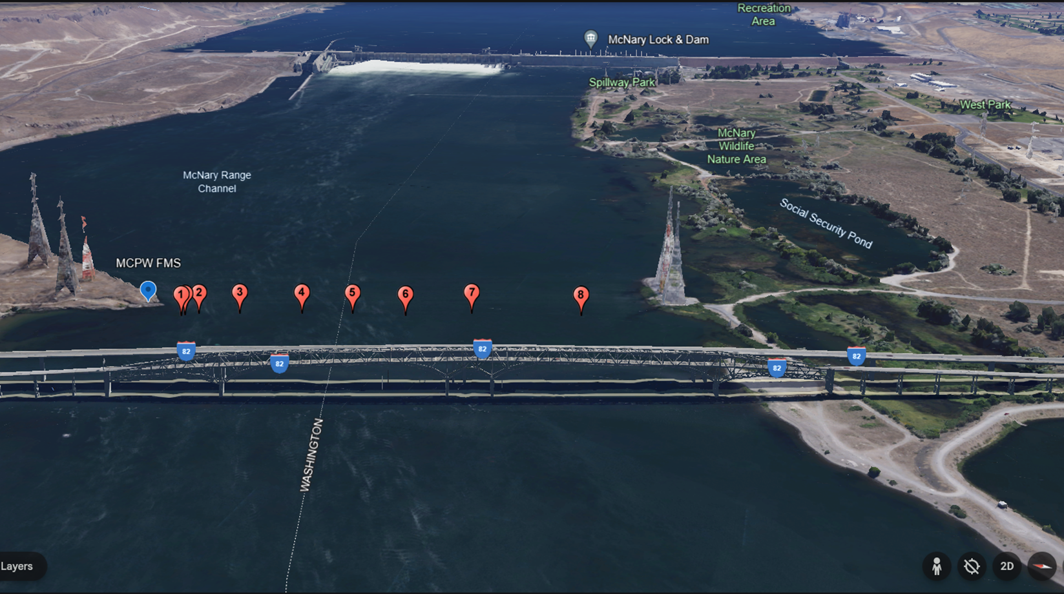
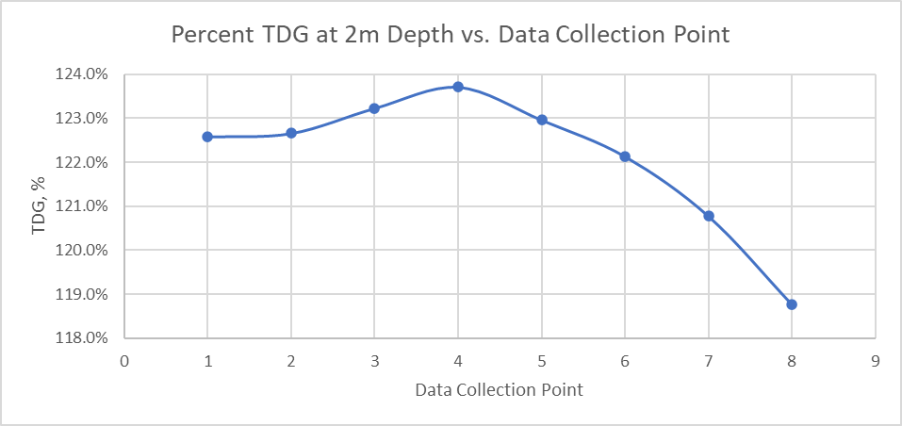
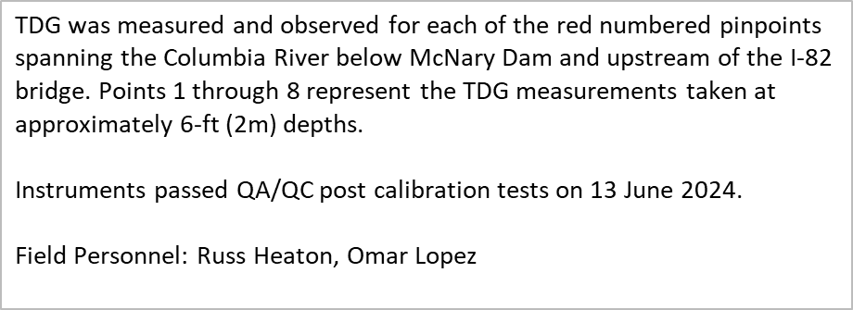

Slide 21
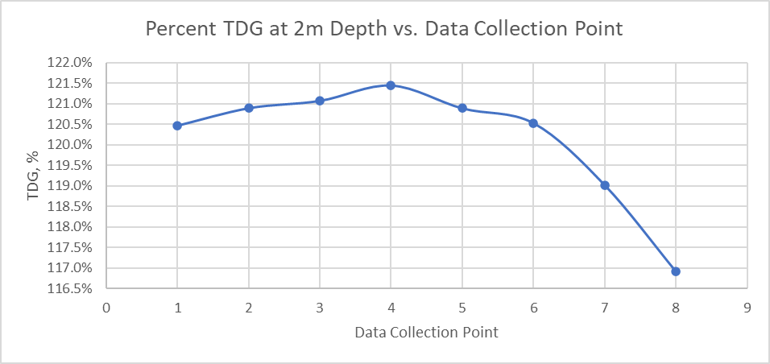
TDG was measured and observed for each of the red pinpoints spanning the Columbia River below McNary Dam and upstream of the I-82 bridge. Points 1 through 8 represent the TDG measurements taken at approximately 6-ft (2m) depths. The red star pin represents the correlation measurement with the Fixed Monitoring Station (FMS) MCPW, taken at approximately 19-ft depth.
Instruments passed QA/QC post calibration tests on 5 June 2024.
Field Personnel: David Towsley, Mishael Umlor

Slide 22
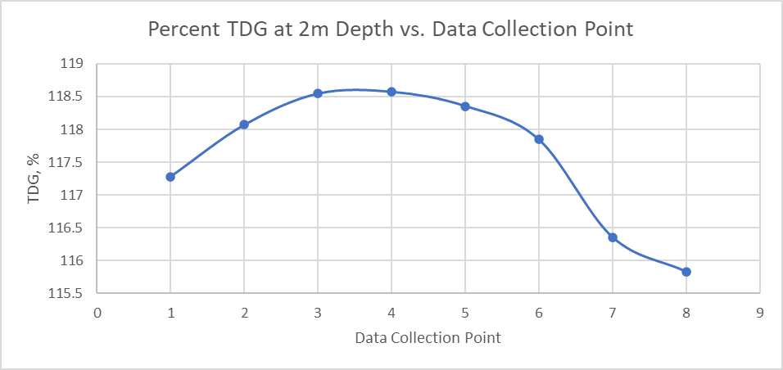
TDG was measured and observed for each of the red pinpoints spanning the Columbia River below McNary Dam and upstream of the I-82 bridge. Points 1 through 8 represent the TDG measurements taken at approximately 6-ft depths. The red star pin represents the correlation measurement with the Fixed Monitoring Station (FMS) MCPW, taken at approximately 20-ft depth.
Instruments passed QA/QC post calibration tests on 17 APR 2024.
Field Personnel: Mishael Umlor, David Towsley

Slide 23
22 February 2024
modified spill operations
Changes in the spill gate and hoist configuration and spill operations creates uncertainty for fish passage at McNary.
Potential Fish Impacts Include:
Altered forebay attraction (SPE and FGE) and tailrace egress conditions, which may cause;
Longer juvenile travel times in the forebay and tailrace
Reduced juvenile reach survival
Passage through split-leaf gate openings may cause physical injury
Estimated lower gas cap spill levels would produce increased PITPH
Poor tailrace flow conditions (eddy formation) may cause adult fish passage delays

Slide 24
If lower flows are expected, spill gates 1 and 2 will remain in the downstream slot and opened to 4 stops (~7 kcfs spill) each and left in that position for the duration of the spill season based on the following hydrologic criteria:
The Dalles April-August ESP-10 water supply forecast volume from the NWRFC is less than 90 MAF on 5 April, and
The STP forecast shows McNary inflows remaining below 350 kcfs through the spring freshet, and
Internal Corps system Flood Risk Management (FRM) analyses conducted weekly indicate a high probability of McNary inflows remaining below 350 kcfs through the spring freshet.

Slide 25
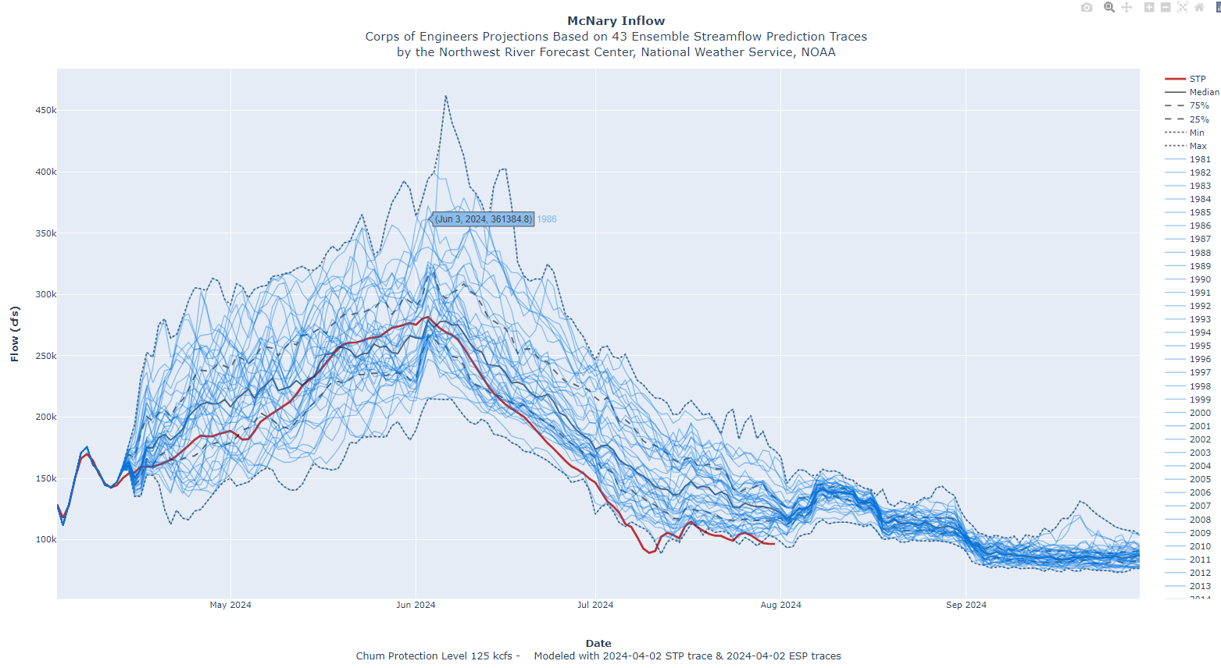

Slide 27
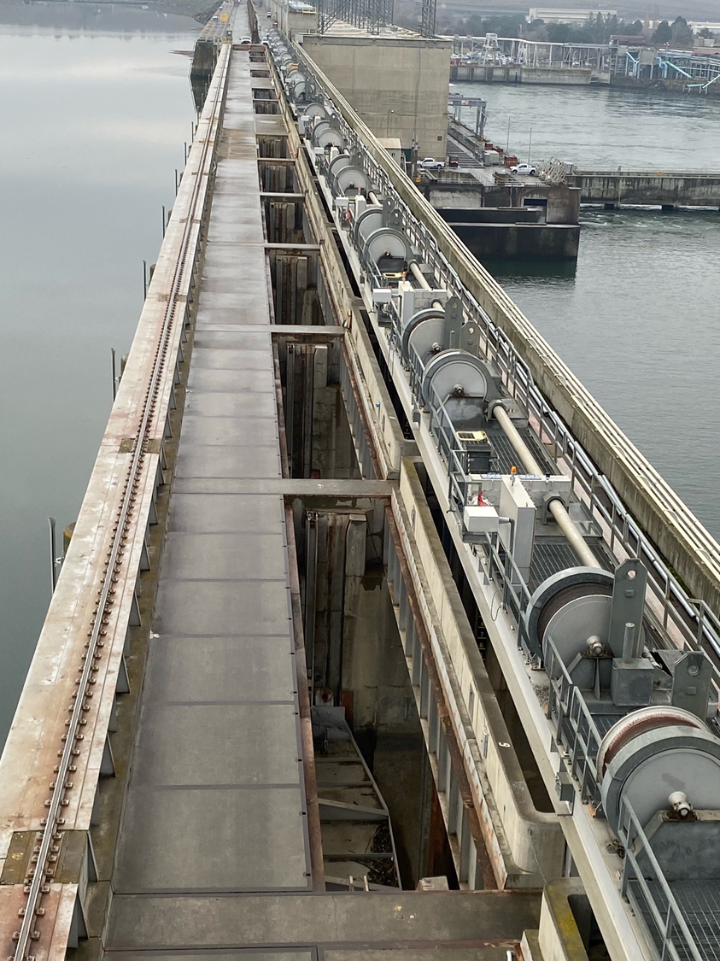
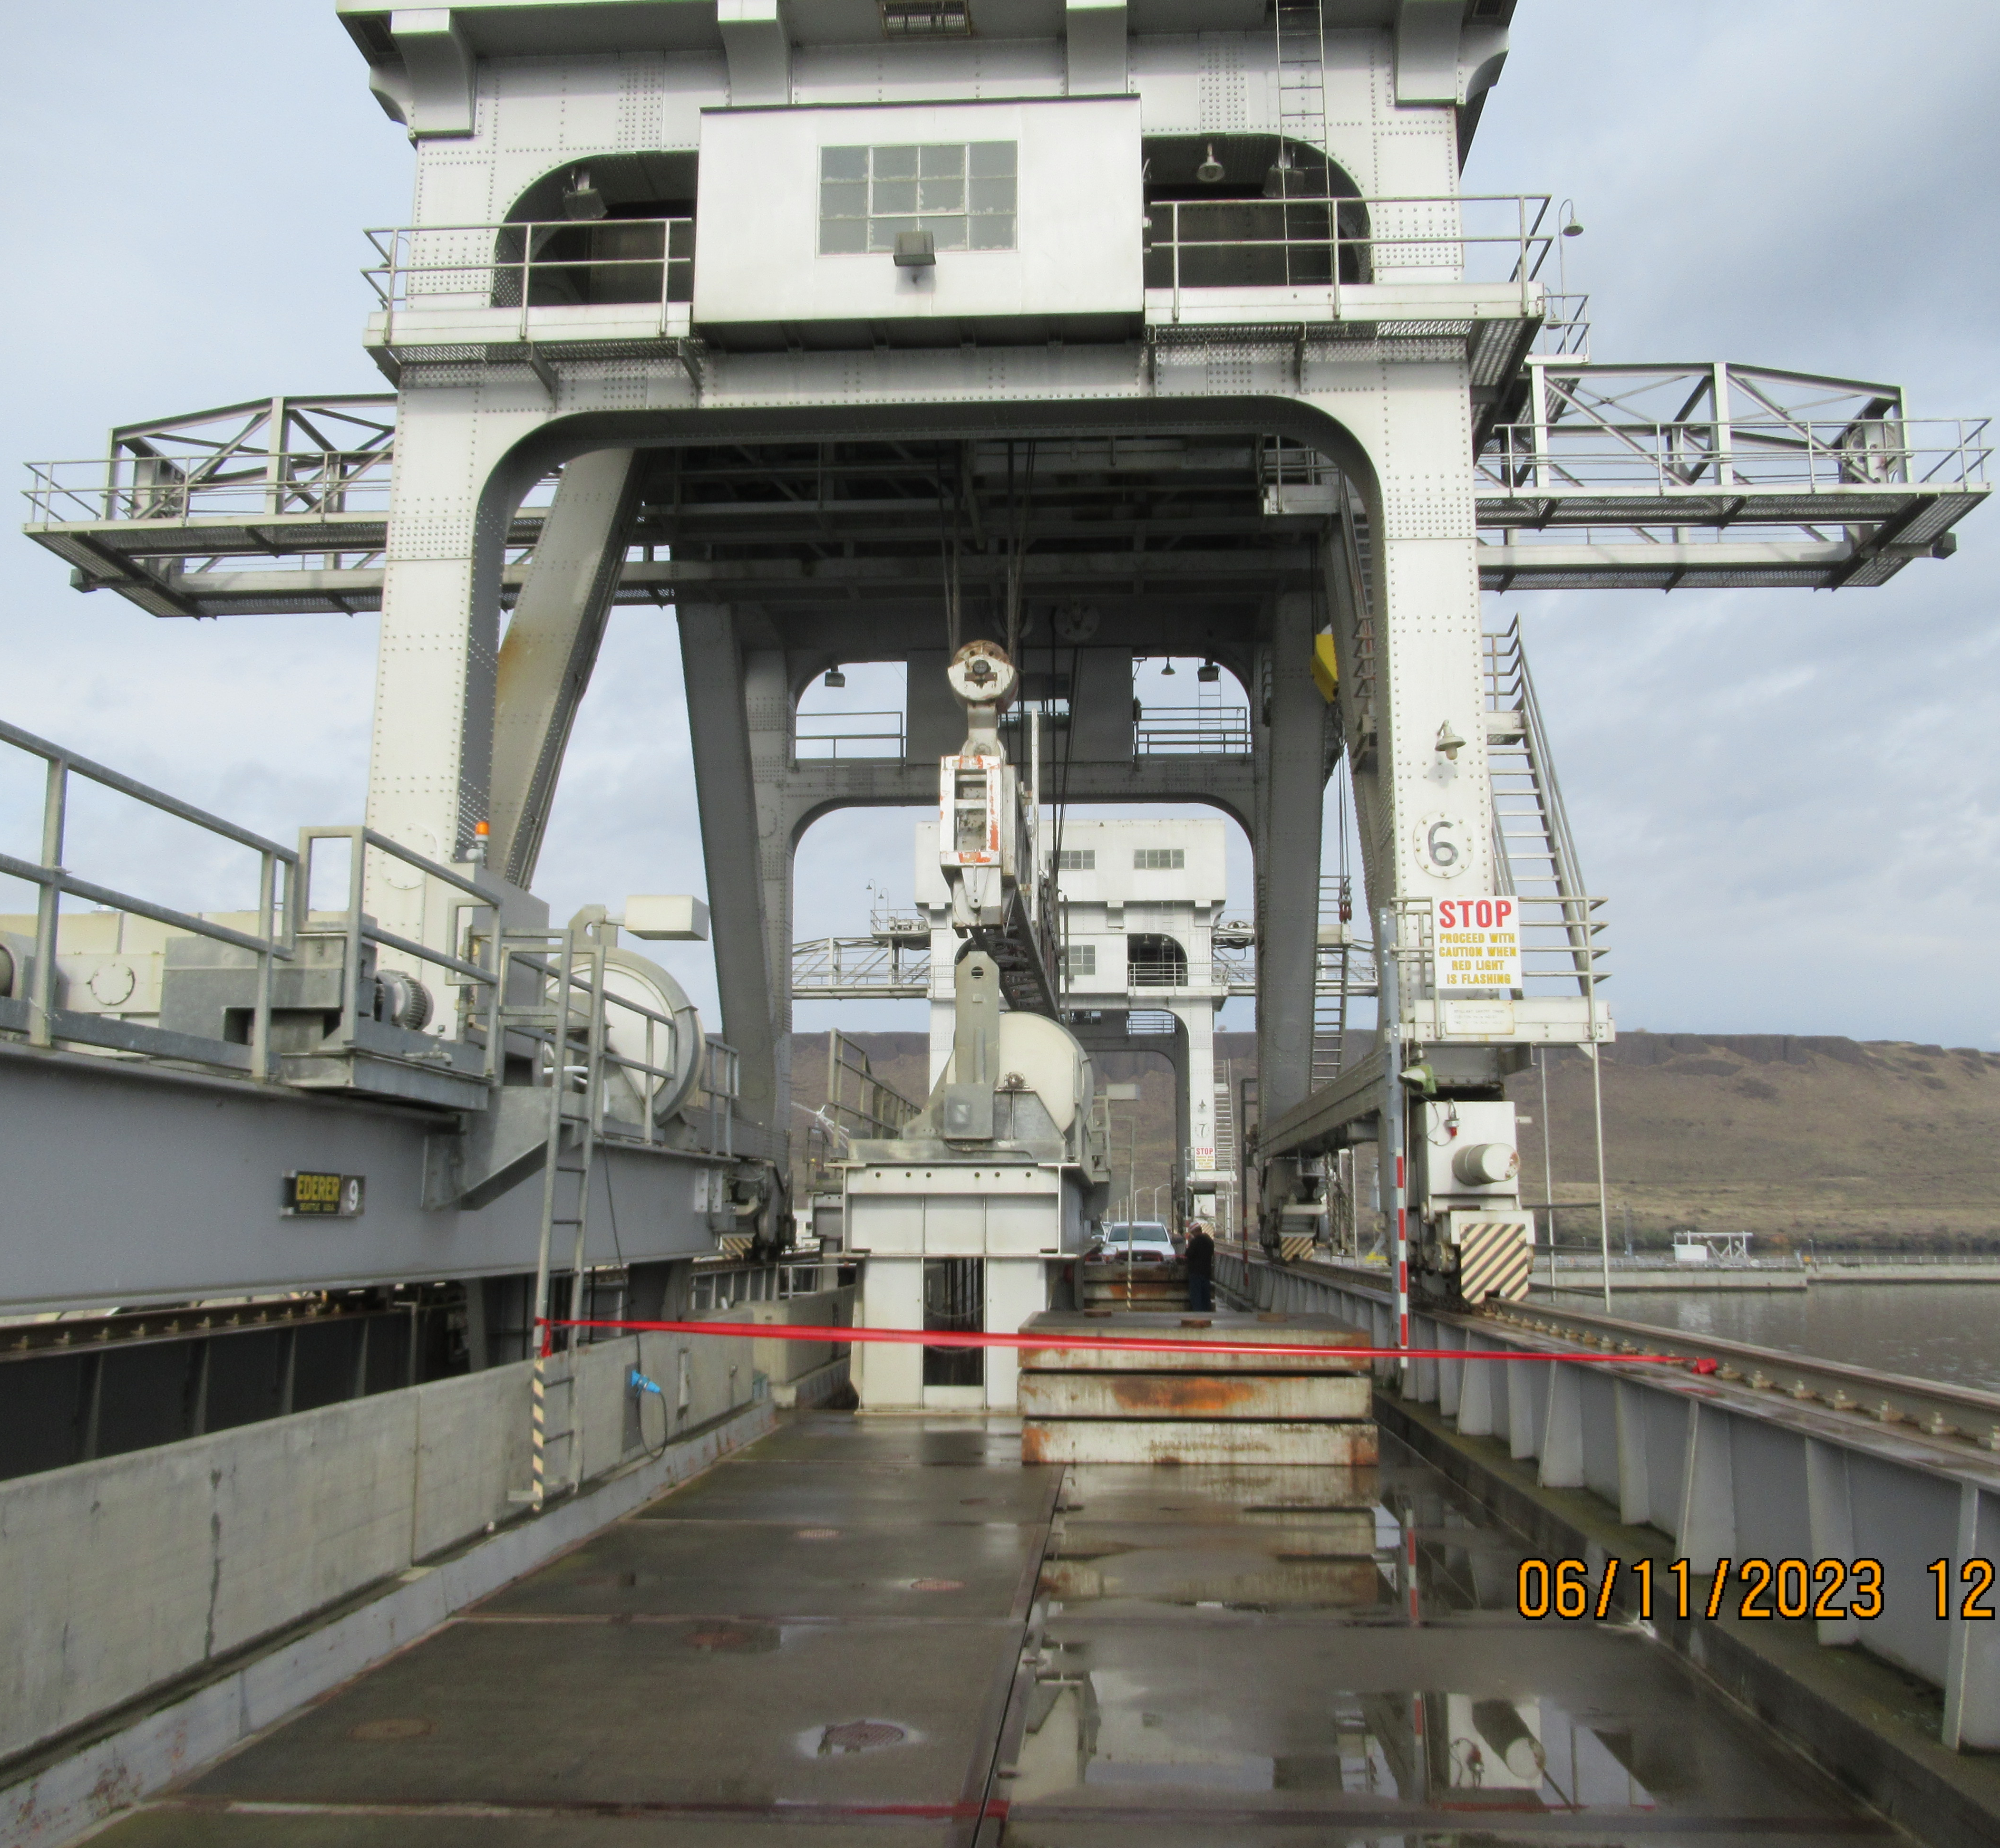

Slide 28
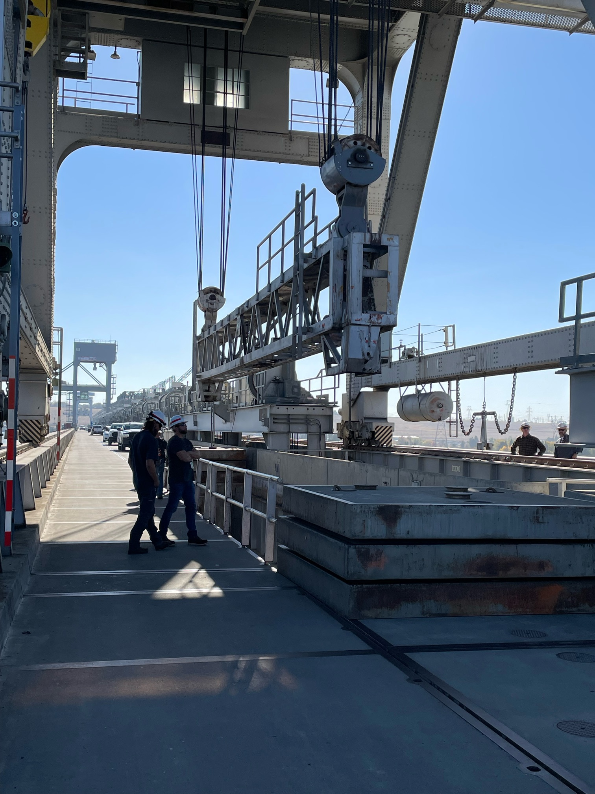

Slide 29
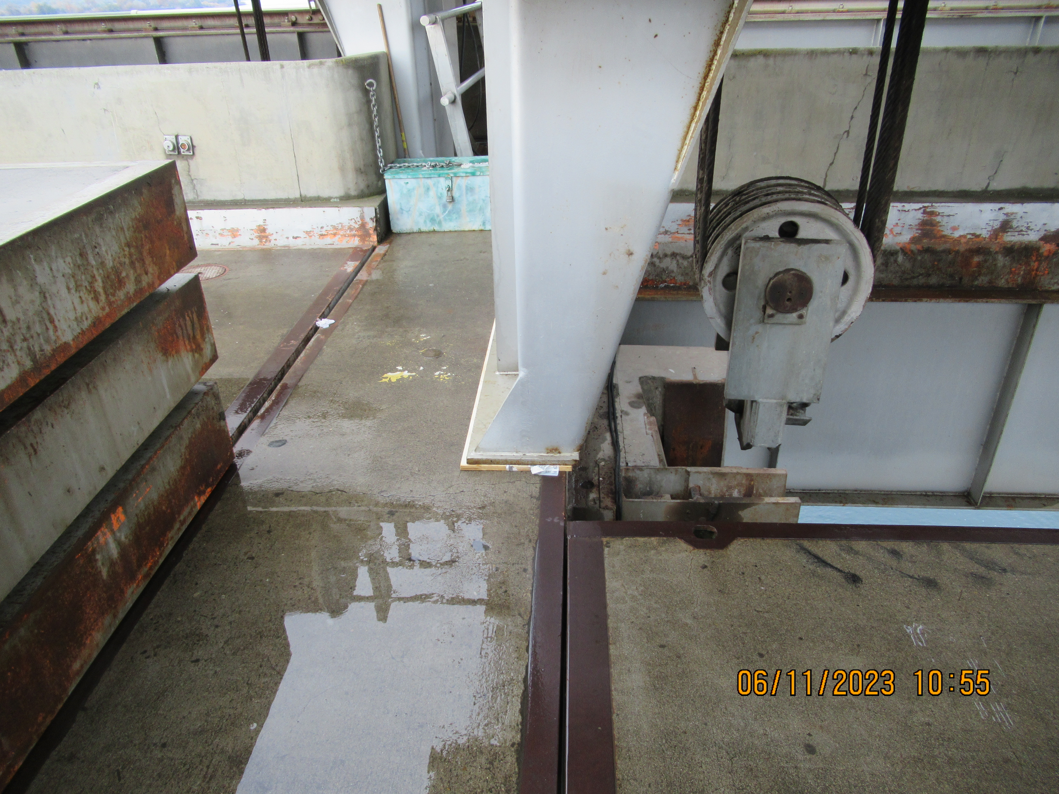

Slide 30
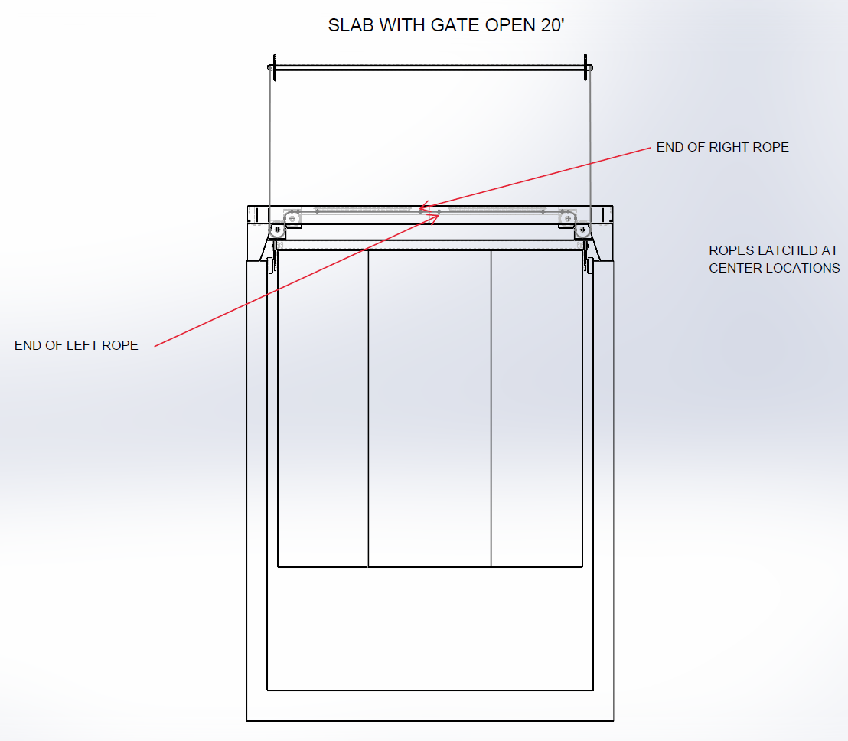

Slide 31
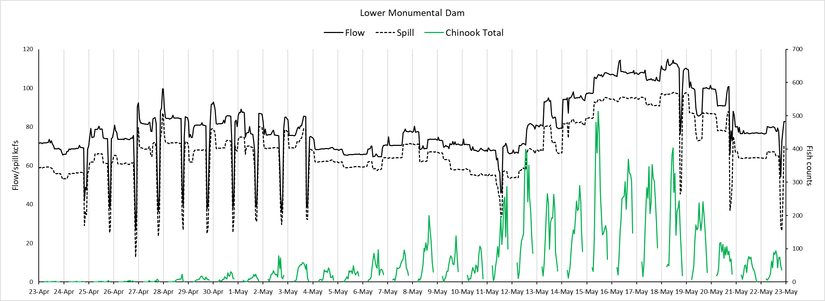
Fish barge operations
Fish barge operations

Slide 32
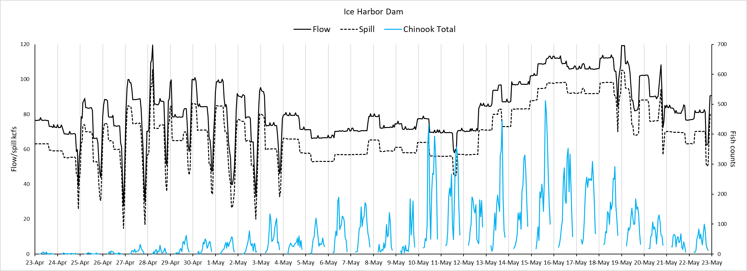
Fish barge operations

